Slide 1
Transport Layer

Slide 2
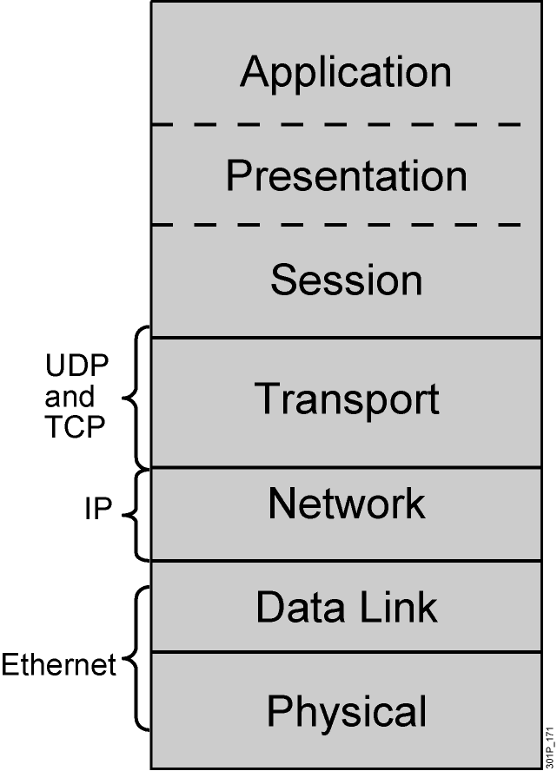
Transport Layer
Session multiplexing
Segmentation
Flow control (when required)
Connection-oriented (when required)
Reliability (when required)
Notes:
Lesson Aim
<Enter lesson aim here.>

Slide 3
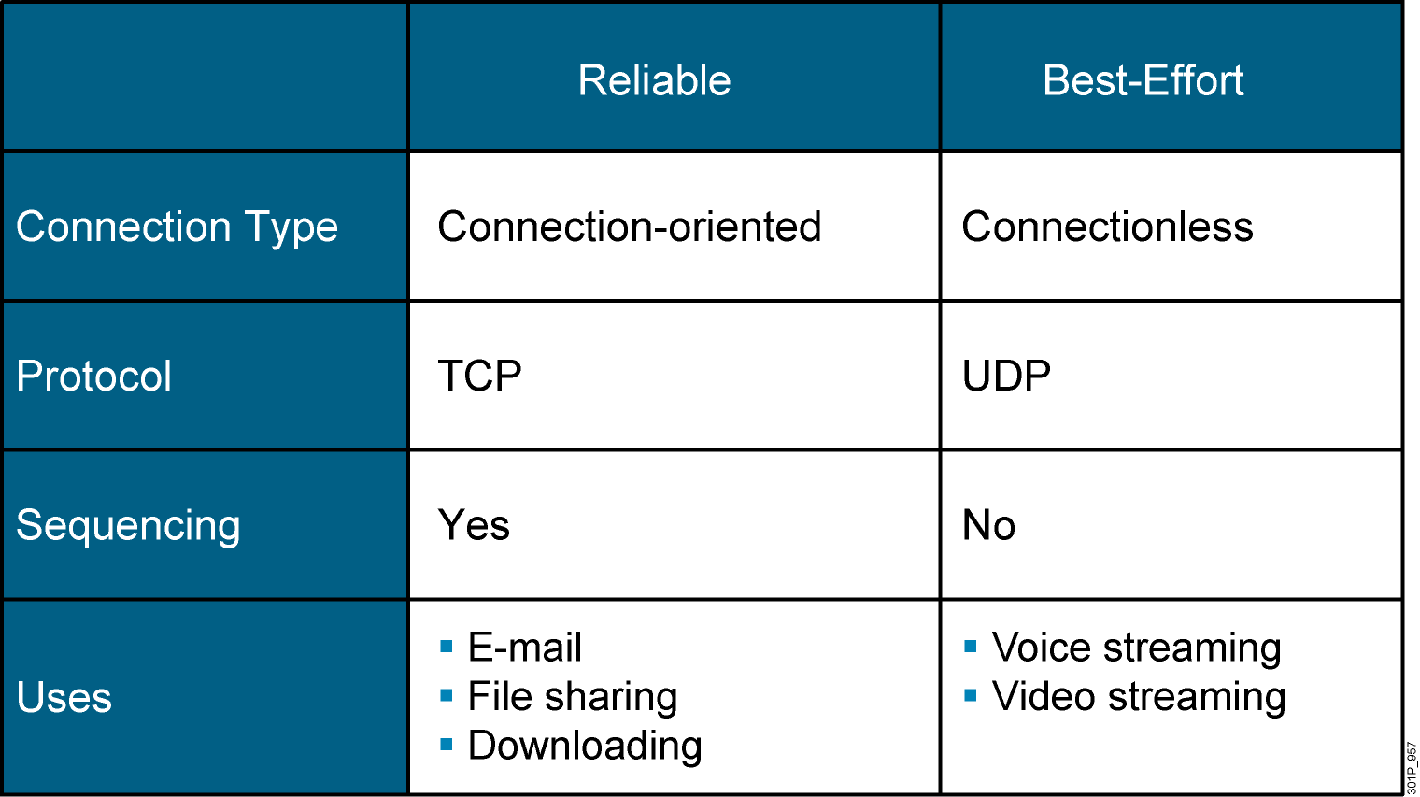
Reliable vs. Best-Effort Comparison

Slide 4
UDP Characteristics
Operates at transport layer of OSI and TCP/IP models
Provides applications with access to the network layer without the overhead of reliability mechanisms
Is a connectionless protocol
Provides best-effort delivery
Provides limited error checking
Has no data-recovery features

Slide 5
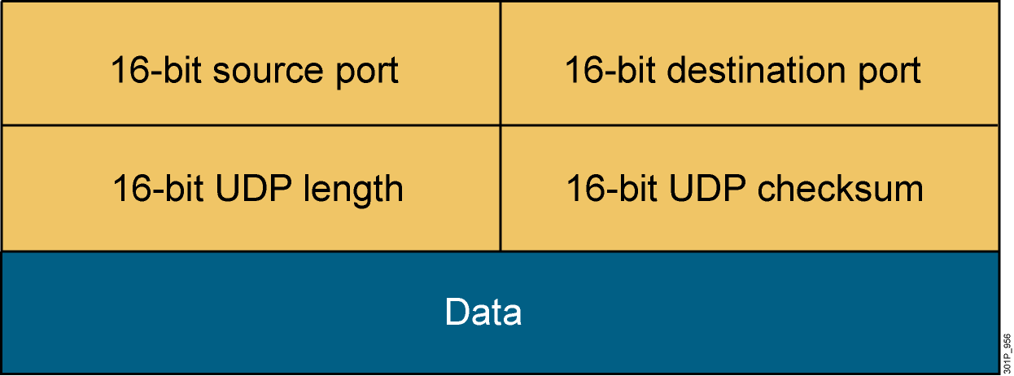
UDP Header

Slide 6
TCP Characteristics
Transport layer of the TCP/IP stack
Access to the network layer for applications
Connection-oriented protocol
Full-duplex mode operation
Error checking
Sequencing of data packets
Acknowledgement of receipt
Data-recovery features

Slide 7
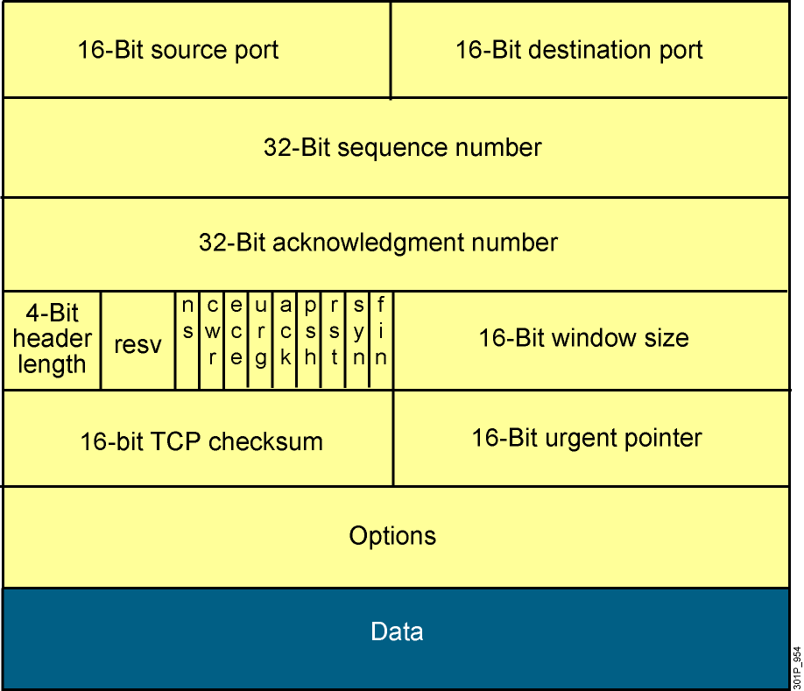
TCP Header
Notes:
Lesson Aim
<Enter lesson aim here.>

Slide 8
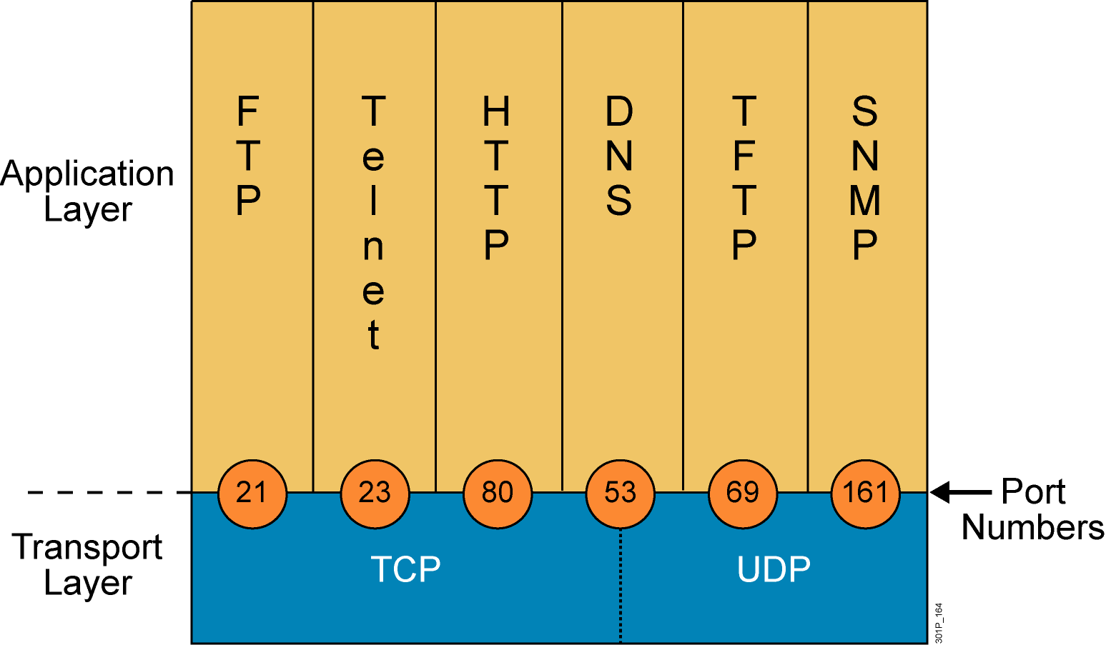
Mapping Layer 4 to Applications
Notes:
Lesson Aim
<Enter lesson aim here.>

Slide 9
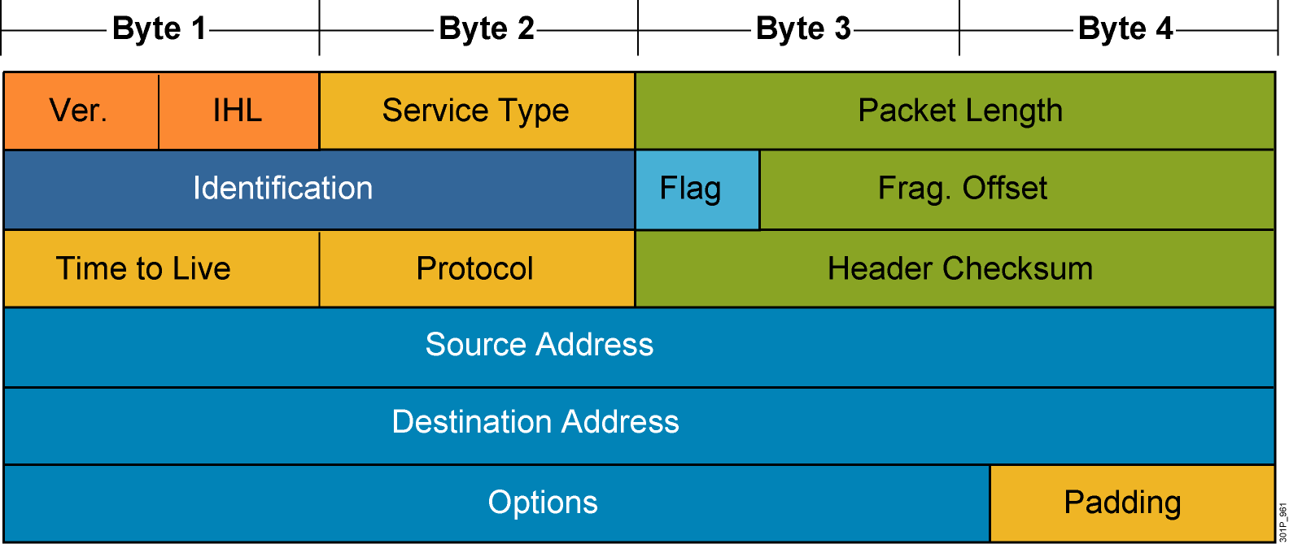
Mapping Layer 3 to Layer 4
Notes:
Protocol ID: 6 – TCP 17 – UDP 89 - OSPF 88=EIGRP

Slide 10
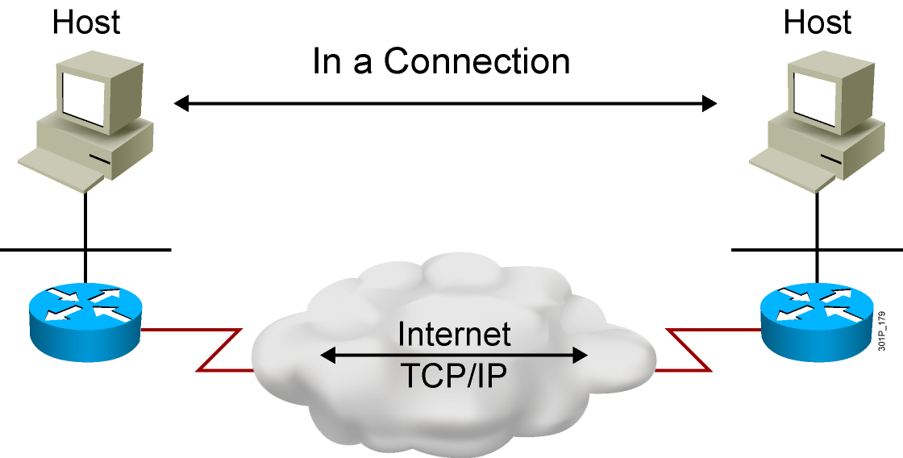
Establishing a Connection

Slide 11
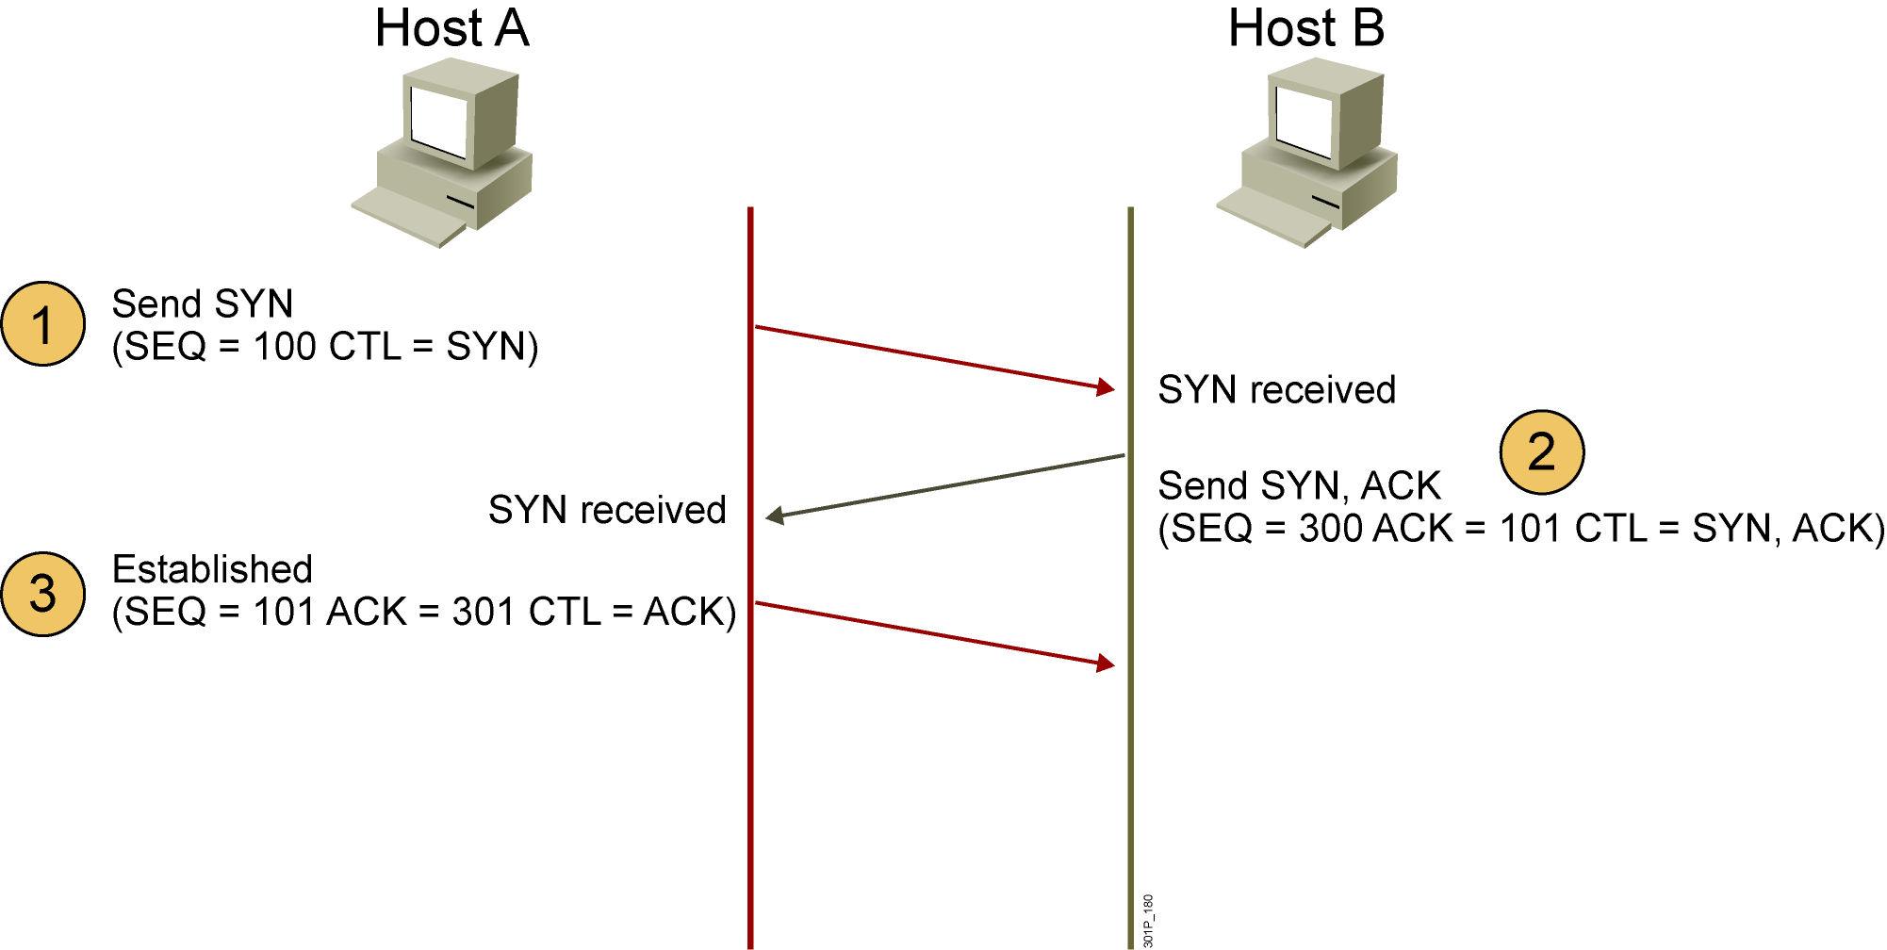
Three-Way Handshake
CTL = Which control bits in the TCP header are set to 1

Slide 12
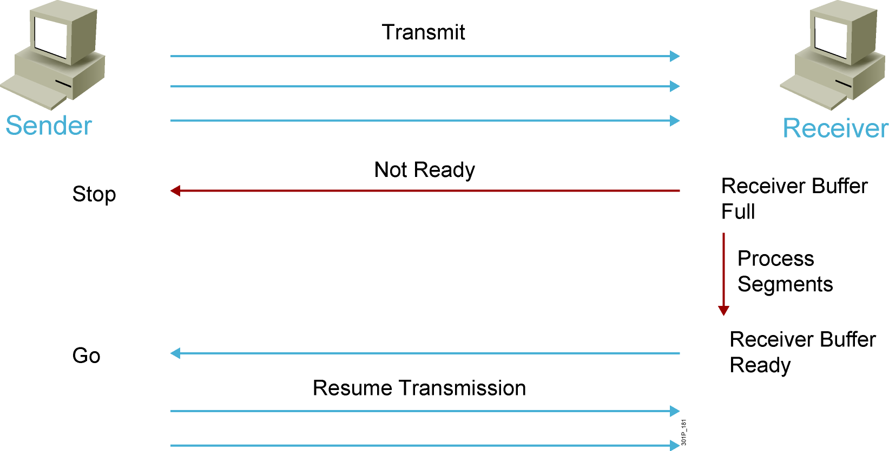
Flow Control
Notes:
Lesson Aim
<Enter lesson aim here.>

Slide 13
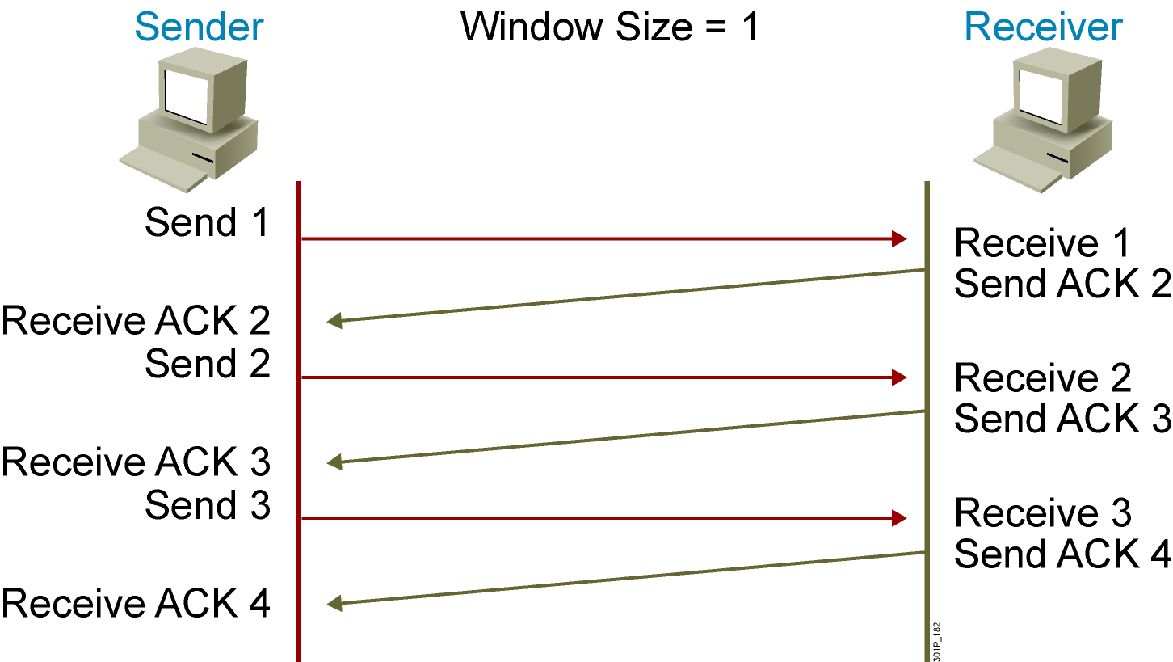
TCP Acknowledgment
Notes:
Lesson Aim
<Enter lesson aim here.>

Slide 14
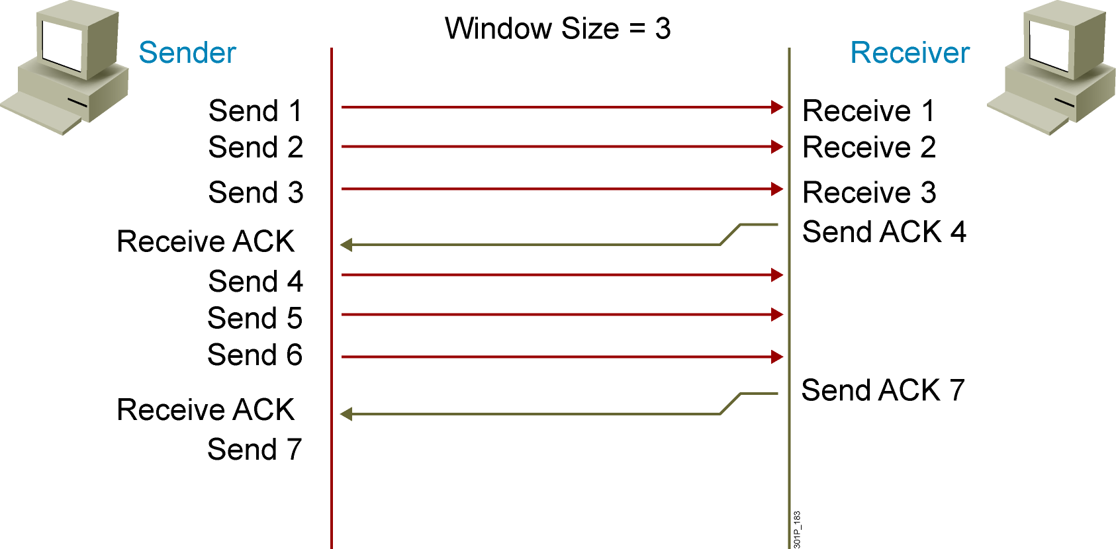
Fixed Windowing
Notes:
Lesson Aim
<Enter lesson aim here.>

Slide 15
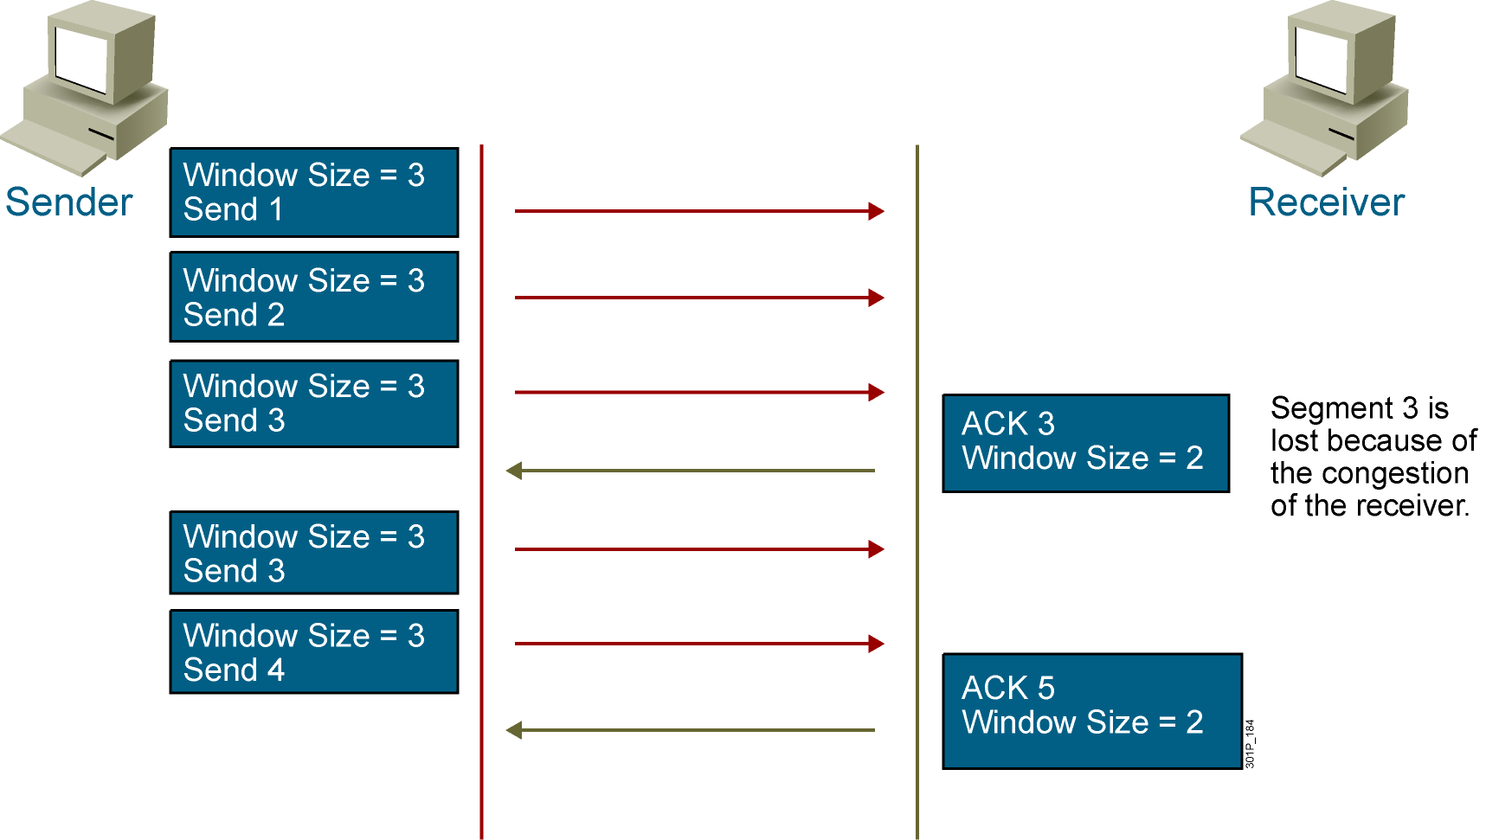
TCP Sliding Windowing
Notes:
Lesson Aim
<Enter lesson aim here.>

Slide 16
Network Layer

Slide 17
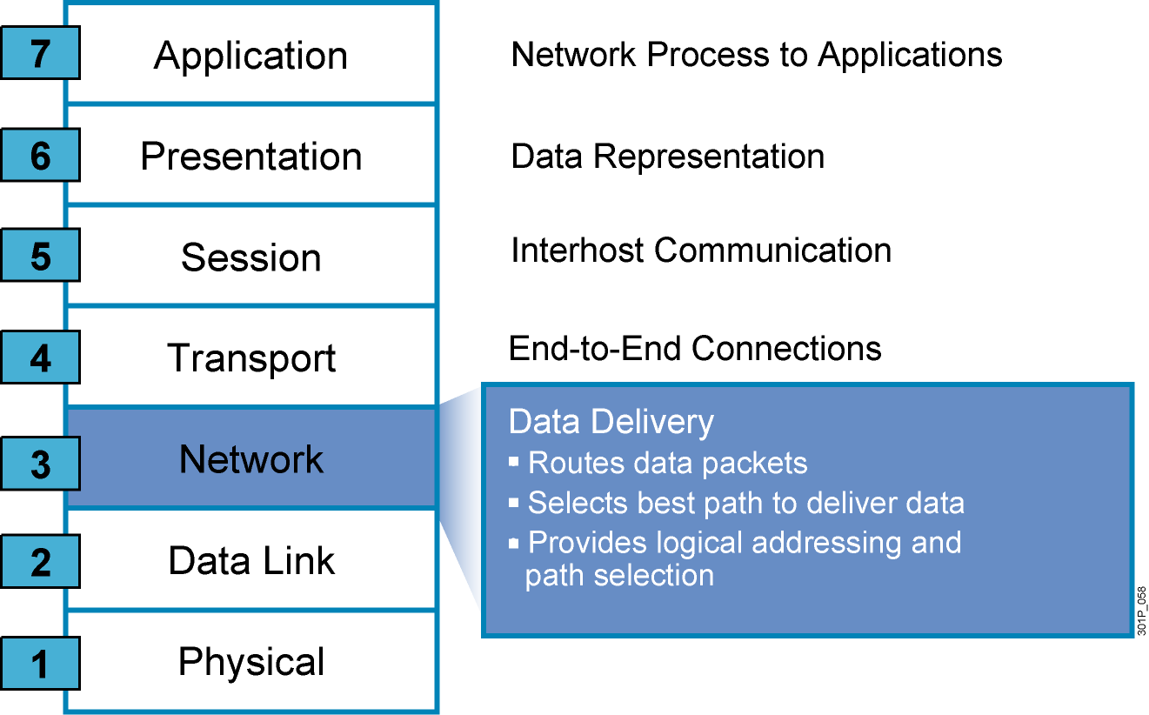
Network Layer

Slide 18
Internet Protocol Characteristics
Operates at network layer of OSI
Connectionless protocol
Packets treated independently
Hierarchical addressing
Best-effort delivery
No data-recovery features

Slide 19
IP PDU Header

Slide 20

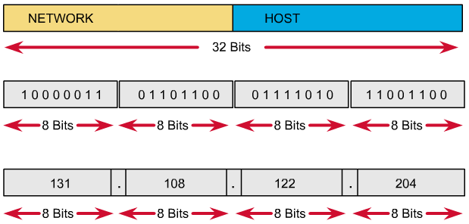
IP Address Format

Slide 21
IP Address Format
All network part bits cannot be set to all binary 0.
If all host part bits is set to all binary 0, we have a network address.
If all host part bits is set to all binary 1, we have a broadcast address.

Slide 22
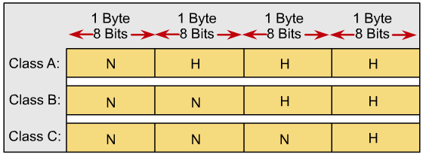
IP Address Classes

Slide 23
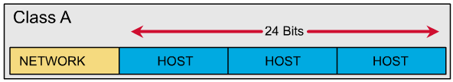
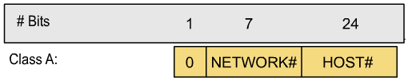
Class A

Slide 24
Class A
Network address:
1.0.0.0 -> 127.0.0.0
Network 127.0.0.0 : loopback network
Usable network address: 1.0.0.0 -> 126.0.0.0 (126 network).
Host part: 24 bits => Every class A network have 2^24 – 2 hosts.

Slide 25
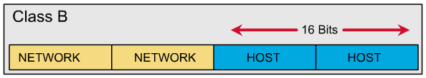

Class B

Slide 26
Class B
Network address :
128.0.0.0 -> 191.255.0.0
There are all 2^14 networks in class B network.
Host part : 16 bits
Every class B network have 2^16 – 2 hosts.

Slide 27
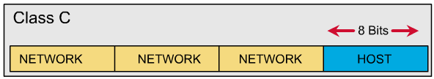
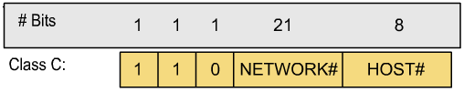
Class C

Slide 28
Class C
Network address:
192.0.0.0 -> 223.255.255.0
There are all 2^21 networks in class C network.
Host part: 8 bit
Every class C network have 2^8 – 2 = 254 hosts.

Slide 29
Class D
Network:
224.0.0.0 -> 239.255.255.255
Multicast address.
Example: 224.0.0.5 is used for OSPF
224.0.0.9 is used for RIPv2

Slide 30
Class E
From 240.0.0.0 to the end.
Reserved.

Slide 31
Broadcast
Direct broadcast
Example: 192.168.1.255
Local broadcast
255.255.255.255

Slide 32
Private and Public
In LAN: Private.
In Internet: Public.
IP private range (RFC 1918):
Class A: 10.x.x.x
Class B: 172.16.x.x -> 172.31.x.x
Class C: 192.168.x.x
NAT: Translate private <-> public.
IP Private address help conserve IP public address.

Slide 33
Subnet mask and Prefix-length
Subnet mask
Class A: 255.0.0.0
Class B: 255.255.0.0
Class C: 255.255.255.0
Prefix-length
Class A: /8
Class B: /16
Class C: /24

